Slide 1

T01
BASIC LEAN TRAINING
Principle 1
Specify what is value for the customer
The European Commission's support for the production of this publication does not constitute an endorsement of the contents, which reflect the views only of the authors, and the Commission cannot be held responsible for any use which may be made of the information contained therein.

Slide 2

Objectives
The objectives of this chapter are:
Identify what value means from the customer point of view.

Slide 3
Principle 1
Specify what the VALUE is for the customer
Tools:
Kano model
Added value
Waste

Slide 4
Exercise: “The Card Game”
Notes:
Code “T01E2” (Card Game)

Slide 5




The Kano model for understanding customer perception
Principle 1
Kano Model
Delighters
Wish
Basic needs
Notes:
Teacher: Explains what fulfills the basic needs and what exceeds them.
Example hotel: Basic needs is a bed, that it is clean, a window, toilet paper, etc. and what may exceed expectations may be a bottle of champagne, a chocolate waiting for you on the pillow, etc. This differs from person to person.
(Maslows´ Pyramid)
Exercise: Students think of a mobile phone and write what they consider to be “Basic Needs” / “Wish Factor” / “Wow factor” (A4 divided in 3 columns)

Slide 6

Principle 1
Kano Model
An example of a basic factor…

Slide 7

Principle 1
Kano Model
An example of a wish factor...

Slide 8
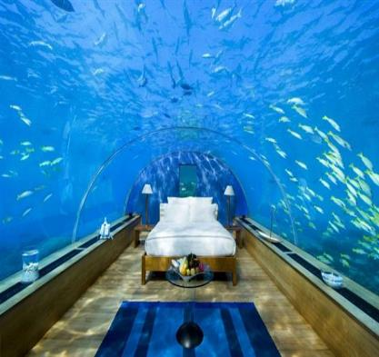
Principle 1
Kano Model
An example of a delight factor...

Slide 9
Principle 1
Kano Model
Think on a mobile device…
Basic factor
Wish factor
Wow factor

Slide 10
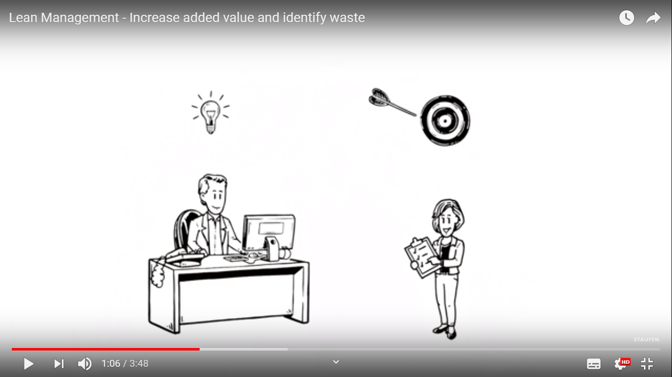
Principle 1
Added value
Ref: 8.11.2018 by Stauffen www.stauffen.ag
Notes:
T01 V1 (Video Lean Management - Increase added value and identify waste)

Slide 11
Principle 1
Added value
Define value clearly and correctly from the customer’s point of view
Value is:
    always defined by the client
    everything that the customer is willing to pay for (product / service)
    any activity that physically modifies the product / service or adds relevant information.
Notes:
We are all customers and suppliers (internal / external)
Value is what you take, price is what you pay - what any customer wants is that the price is justified by the value that is taken. Otherwise, the customer will look for another supplier, the one that guarantees a difference between value and minimum price.
Everything that is not value is waste / not added value.

Slide 12

Principle 1
Waste
Types: Mura | Muri | Muda
Activities:
    Completely unnecessary → Waste
    That can’t be eliminated by 100% → No added value
    Originate unnecessary cost
X

Slide 13
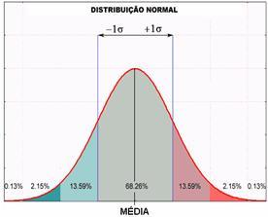
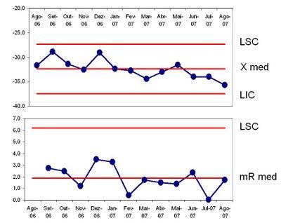
Principle 1
Waste
Mura | Muri | Muda
Is related with variability
For example:
  Flow
  Response time
  Production time

Slide 14
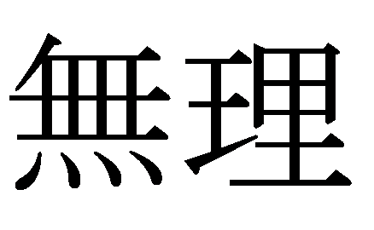
Principle 1
Waste
Mura | Muri | Muda
Is related to excess
For example:
  Work Load
  Safety
  Ergonomics
  Random activities (non-standard work)
Notes:
Means “heavy burden”
It’s a vast concept and is applicable to almost everything

Slide 15
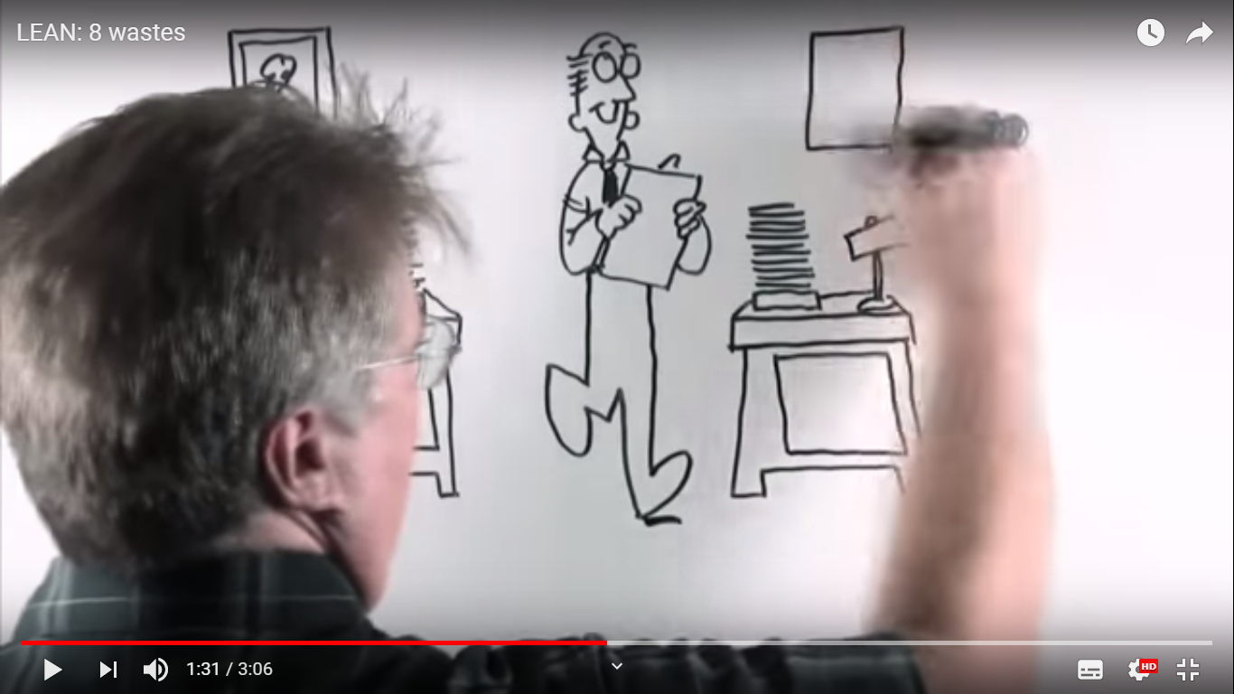
Principle 1
Waste
Ref: 10.6.2016 by TECOENERGYinc.
Notes:
“Waste” vídeo reference T01-V2 Waste

Slide 16
Principle 1
Waste
Mura | Muri | Muda
Is related to non-value added activities
The 7 Wastes:
  Over production Transport In the Process itself
  Movement Waiting Defects Stock
Notes:
Mr. Ohno when he found that productivity was low because the production system defined a concept about value and waste and identified 7 types of waste.
Mr. Ohno, the great founder of the Toyota Production System, proposed that the waste be divided into 7.
With the evolution of the organizations, the types of waste have evolved. In particular:
1. Lack of communication
2. Non-ergonomic drives
3. Energy
4. The disapproval of ideas, creativity, the skills of the workers themselves
Teacher can give the information that if the students want to explore some more details about the 7 waste, they can go to “Thingling”, choosing service and care, office or manufacturing environment.

Slide 17
Overproduction
1
Stock/Inventory
2
Movement
3
4
Waiting
Transport
Overprocessing
6
5
Defects
7

Slide 18
Here’s the good news about waste.
Every time you identify waste within your organization,
you have found an opportunity for improvement!

Slide 19
LEAN FOR WORK AND LEAN FOR LIFE
Train the trainer to teach Lean skills in VET

