Slide 1
T00- B
BASIC LEAN TRAINING
Introduction to Lean
The European Commission's support for the production of this publication does not constitute an endorsement of the contents, which reflect the views only of the authors, and the Commission cannot be held responsible for any use which may be made of the information contained therein.

Slide 2
Objectives
The objectives of this chapter are:
General idea what Lean is about
Introduction to Lean examples

Slide 3
Know – Wonder – Learn (KWL) Chart
TOPIC
What do you already know (or think you know) about Lean? | What do you wonder about Lean?

Slide 4
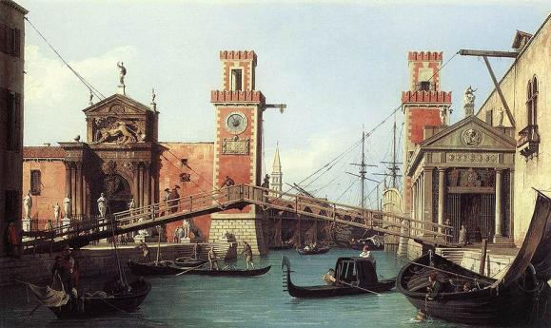
Introduction
Lean Production’s history
16th century
The Venice Arsenal developed mass production methods for the production of warships, building first the keel of the boat, replacing the old Roman system of building the hull first. This system was much faster and required less wood.
Venice Arsenal
Notes:
[1] http://pt.wikipedia.org/wiki/Arsenal_de_Veneza

Slide 5
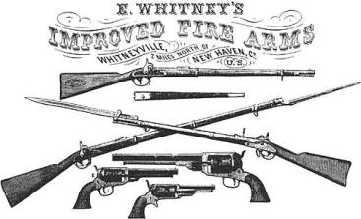
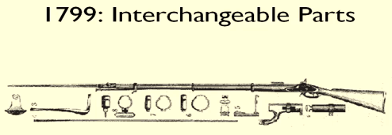
Introduction
Lean Production’s history
1811
Eli Whitney created a production system that allowed low-skilled employees to produce a finished product with the same quality as a specialist doing it by himself, but with a much higher production speed.
E. Whitney
Notes:
[2] http://www.eliwhitney.org/new/museum/eli-whitney
http://pt.wikipedia.org/wiki/Eli_Whitney
Jefferson had seen the work of the brilliant Honore` Blanc who had developed a system of interchangeable parts in France.
Without a factory, without even a machine, he persuaded the U. S. government to give him an order of ten thousand muskets at $13.40 each, to be delivered within two years.
Every rifle had been made by hand from stock to barrel; but the parts of one gun did not fit any other gun, nor did anyone expect them to. It was Whitney's idea to make all the parts of his rifles so nearly identical that the machines parts could be interchangeable from one gun to another.
For each part of the gun, a template was made. This was identical in principle to the dress pattern. A man would follow this pattern in cutting a piece of metal. Whitney then had to invent a machine that would allow a man to cut metal according to a pattern. The metal plate to be cut was clamped to a table, the template to be followed would be clamped on top of the metal, and a cutting tool would follow the outlines of the template.
This invention, subordinate to the entire system, was itself a major innovation. It was called the milling machine, and remained unchanged in principle for a century and a half.
Arms manufacturing had changed little in the 18th century. In a long apprenticeship, gunsmiths learned to forge, carve and shape each intricate piece of a musket. European nations were reluctant to let these craftsmen emigrate.
Facing a shortage of skilled, affordable craftsmen Whitney built a plan: create tools to ease the skill required of workers. Drive tools by water. Organize work so that a man need master the fashioning of but a few parts. Whitney’s factory will produce a strategy of working that will shape 19th century America. It is a change in organization and process that will lead to vast material changes.
It would take Whitney ten years to fill the contract he had promised to complete in two.

Slide 6
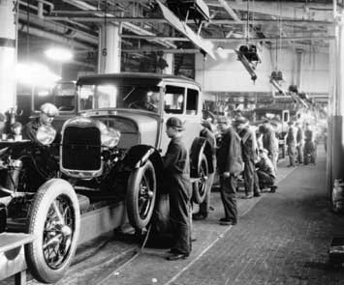
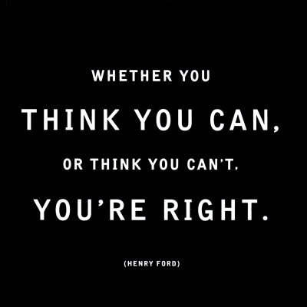
Introduction
Lean Production’s history
Mass production of the Ford model T
1913
Henry Ford creates the 1st industrial assembly line. He created a system where the car was moved towards the stationary worker. Mass production of the Ford model T.
Notes:
[3] http://pt.wikipedia.org/wiki/Henry_Ford

Slide 7
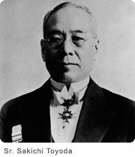
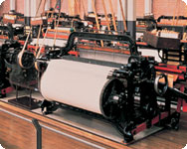
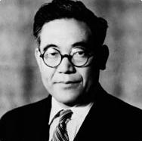
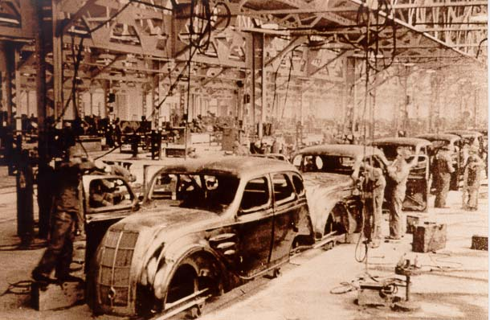
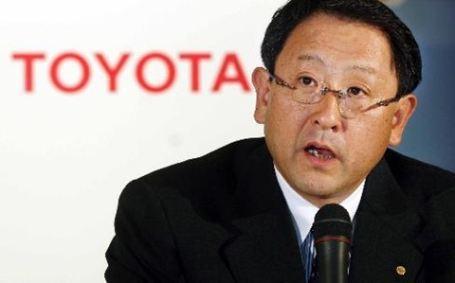
Introduction
Lean Production’s history
TOYOTA history
End of 19th century: Invents an automatic loom
1918: Toyoda Spinning and Weaving Company
1937: Toyota Motor Corporation
2010: Akio Toyoda
Mr. Sakishi Toyoda
Spinning and Weaving Co.
Mr. Kiichiro Toyoda
Toyota Motor Corporation
AkioToyoda
Notes:
[4] http://www.toyota.co.jp/en/history/index.html
1698: steam engine (GB)
1780: steam loom (GB)
1913: Henry Ford creates the 1st industrial assembly line
Toyota's story begins with Sakichi Toyoda born in 1867 and the son of a modest carpenter. At that time, Japan was starting to take the first steps towards transforming the agricultural country into a modern and highly industrialized country. Thus, from a very young age Sakichi, taking advantage of his knowledge of carpentry, began by transforming the loom of his mother and later, the neighbor's (at that time to help the family, peasant women worked at home on manual looms) eventually patenting an automatic loom in 1891, moving to Tokyo to dedicate himself to the improvement and manufacture of looms.
In 1893 he married and had a son named Kiichiro. The loom business is increasing dramatically despite the setbacks caused by the wars and the economic recession, but in (...) when it visits the USA it marvels at the automobiles and soon thinks of launching that industry in Japan. However, this idea was getting on the shelf until in 1930 his son, a year after his death, and taking advantage of the money obtained in the sale of the patents of looms, launches in the study and manufacture of motors of internal combustion.
In 1933, Kiichiro Toyoda founded the Toyota Motor Corporation (the change of name from Toyoda to Toyota was justified because according to Kiichiro the name brought more luck according to the Japanese traditions, it was also his will to separate his nickname from the companies name and in addition was easier to pronounce) and in 1934 appears the first Toyota type A engine that will equip the prototype Model A1 of passenger car in May of 1935 (from which it derives the Model AA) and the commercial G1 in August of 1935. are practically a copy of the Dodge Power Wagon, even some parts are interchangeable. The AA model begins to be produced in 1936 and until 1942 produced 353 units. At the same time it produced the AB model, which was a convertible with a rolling canvas hood and much like the Sedan.? When in 1987 Toyota Motor Co celebrated its 50th anniversary (the company became fully independent in 1937) sought a model AA, for being his first passenger car, but could not find any survivors so he had to make a replica. That's what's in the Toyota museum.

Slide 8
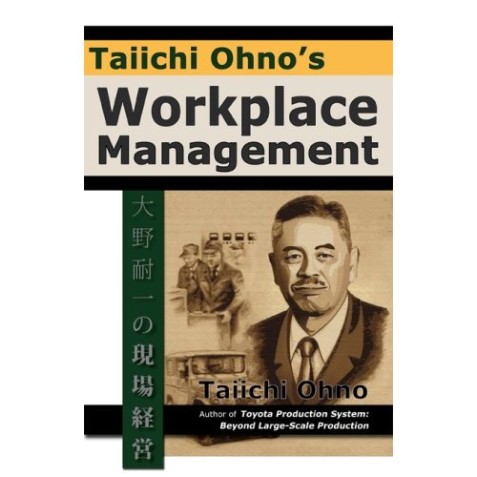
Introduction
Lean Production’s history
1956
2nd World war reduced sales and decreased profitability
USA vs Japan’s productivity
Look for the most efficient production method for the elimination of waste
Toyota Production System – Lean Production
Notes:
Kiichiro Toyoda resigned in 1948 due to reduced sales and low profitability of the company. The fact that there was a competitiveness between the two countries and knowing that Japan's productivity was much lower than the US led to senior managers turning to losses in the production system. In order to specialize in large-scale production of passenger cars and commercial trucks, together with Engineer Taiichi Ohno, they started experimenting with and developing production methodologies that shorten the manufacturing time of the products, -lining lines that would support the final production line. Thus, in 1956 appears the Toyota Production System - Lean Production Current President: Katsuaki Watanabe (2007)

Slide 9
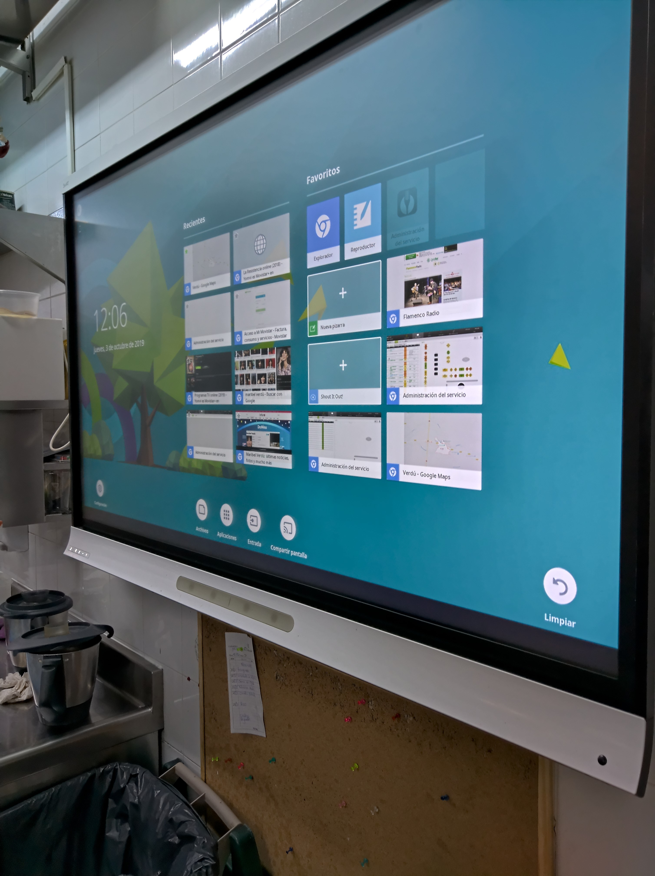
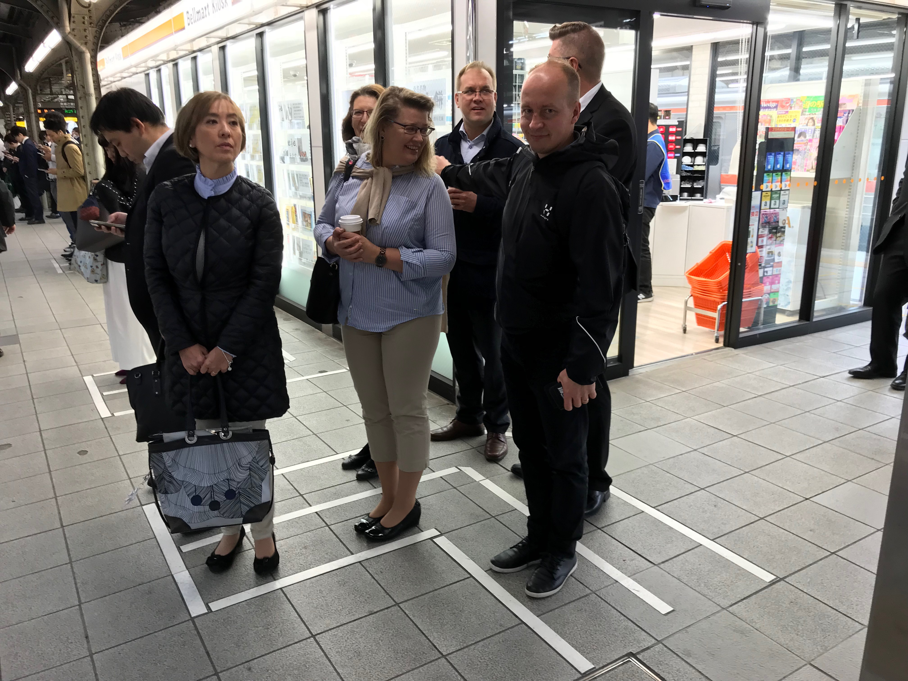
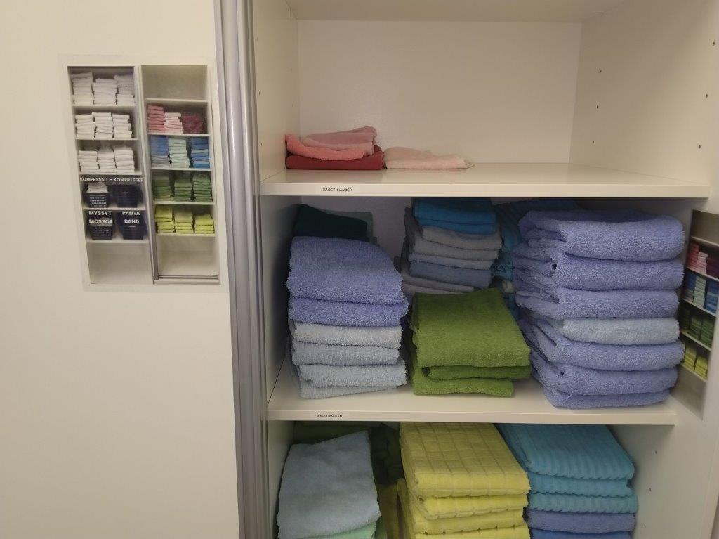
Metro station in Osaka (Japan)
Board in a restaurant for communication between the kitchen & waiters
Towels in a Beauty Shop

Slide 10
Introduction
What is Lean?
Lean
English term meaning ''fat-free ''.
Something that contains only that what is needed.
Lean Manufacturing
Philosophy that focuses on maximizing customer value and eliminating waste.
Also linked to this concept is the establishment of continuous improvement of all operational processes by employees.

Slide 11
Introduction
What is Lean?
Lean Production
Production of a wide variety of products or services in small batches and with reduced manufacturing times.
Other focus areas are quality, flexibility and (low) cost.
Lean Thinking
Management philosophy through which organizations develop competencies towards the gradual elimination of waste and the creation of customer value.

Slide 12
Introduction
What is Lean?
Lean = Toyota Production System (TPS)
In the beginning…
…Today, Lean combines TPS with other good methods.
Lean Production / Lean Manufacturing means to produce and/or supply:
Just what is necessary and in the required quantity
When it is necessary
Where it is necessary

Slide 13
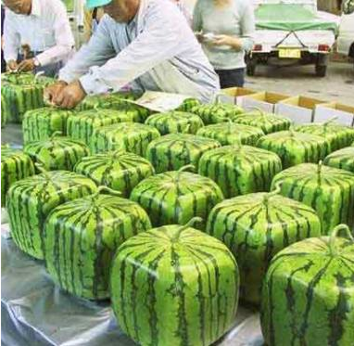
Introduction
What is Lean?
Lean focuses at:
Elimination of waste
Continuous Flow and Pull
Pull concept
Perfection
Notes:
Square watermelon has its origins around 30 years ago, with the good success achieved by some farmers in the Shikoku region of Japan. But its spread came through the media about 9 years ago with the idea of ​​production and import - across the country - from the farmer of the Zintsuji (Kagawa) agricultural cooperative, also in the Shikoku region of Takashi Yamashita, when he discovered that many places in Japan did not sell watermelons because they had no space to store them, as they are huge and round.
To obtain the square shape of the watermelon, during the growth period, (still planted), are placed in square shapes of glass, being forced to grow and take that shape. However in the pursuit of improvement the square watermelon has lost its sweet taste, and because of this the product has mainly a decorative purpose, as it can be preserved for approximately one and a half years.

Slide 14
Introduction
What is Lean?
Advantages:
Reduced production or service time
Inventory reduction
Cost reduction
Increased productivity
Increased customer satisfaction
Notes:
Inventory Reduction: Give some examples from Service areas

Slide 15
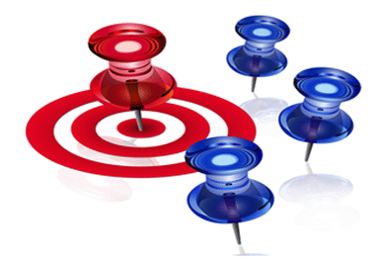
Introduction
What is Lean?
Where can I use Lean?
Services (public or private)
Production / Manufacturing
Information technologies
Health Care Services
Construction

Slide 16
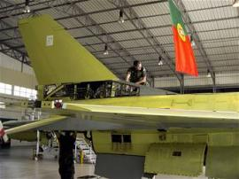
Introduction
Lean examples
Portuguese Air Force
The application of Lean methods led to 60% reduction in maintenance’s Lead Time.
Portuguese electricity company
The Lean project led to time reduction in the replacement after failure in all network areas. In the last 5 years TIEPI (Installed Power Equivalent Interruption Time) has decreased by about 70%.

Slide 17
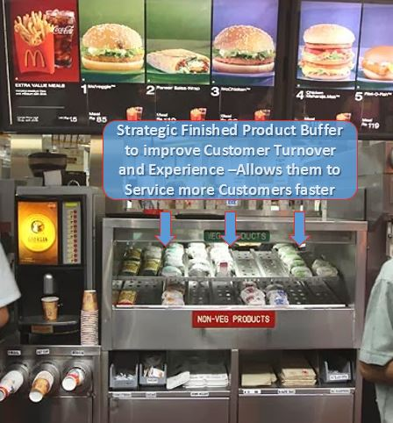
Lean real life at: McDonalds
Notes:
Improves Service Delivery by being available immediately for the customer, thus delivering an effective Customer Experience, and FIFO, First in Firs Out
Acts as a signal to the burger makers in the back that when there is a gap, they have to fill it, this way they don’t over produce (OPERATIONS EXCELLENCE) and only produce what is required. This way they always know what to make next

Slide 18
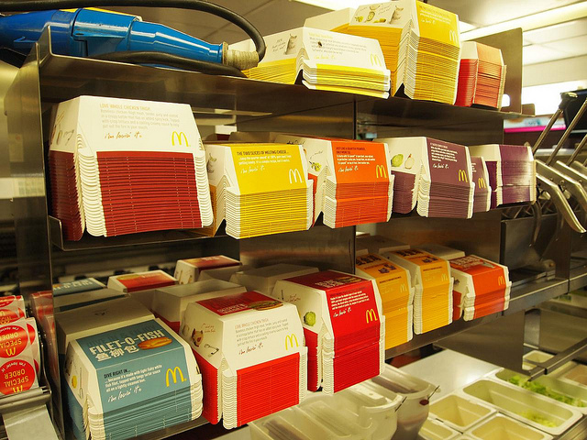
Notes:
Visual management
This strategy allows distributors and retailers to order only after the customers have placed their orders.
Wholesalers keep enough inventory on hand in a warehouse so as to be able to allow distributors and retailers to only keep reasonable storage, but still offer a very efficient service to their clients.
The drop-shipper will send the item directly to the customer, even with the resellers image and logo so as to continue to reinforce the customer relationship.

Slide 19
Introduction
The change in the Market
How markets operate…
Notes:
Question from the Teacher to the Students: Why do you think that companies started adopting this methodology?
(open question)

Slide 20
Introduction
The change in the Market
According to the traditional logic, the price was imposed on the market
With the development of economy markets functioning has changed:
Quality
Low cost/ Fair price
Delivery times
Variety
Companies are no longer setting the price.
This is defined by the CUSTOMER
Notes:
This is the answer to the previous slide

Slide 21
Introduction
The change in the Market
The only way to guarantee the profit margin is a careful management of costs:
Support
Logistics
Services
Operational
Cost reduction | Waste disposal | Value Creation

Slide 22
Other exercises
Ballpoint Pen Game
Notes:
Exercise code: T01 E1)

Slide 23
Lean Thinking’s 5 Principles
Specify the value for the customer
Identify the value chain
Create processes in Continuous Flow
Let the customer ask / “pull” production
Pursuing perfection
Continuously and rigorously practicing the 5 principles leads to the elimination of waste.
The Lean vision is to get a value chain without waste.
Notes:
1) Womack, J., Jones, T, Lean Thinking, Banish Waste and Create Wealth in Your Corporation, 1ª Edição, 1996

Slide 24
LEAN FOR WORK AND LEAN FOR LIFE
Train the trainer to teach Lean skills in VET

